Slide 1
r/place Version 2
Maddie Bomsta, Connie Chou, Melissa LaMette

Slide 2
QMSP Wiki storyline of Rubius and streamer community
“By the way they are [French users] using scripts and bots, yeah it just got leaked. I got a clip where they use bots so it’s ****ing disgusting”, Rubius.
Our Question: Did the French users use bots?
Notes:
The wiki page: https://qsmp.fandom.com/wiki/R/Place_2023#:~:text=Unlike%20other%20subreddits%2C%20r%2FPlace,colored%20pixel%20every%20seven%20minutes.
Rubius quote: https://www.youtube.com/watch?v=9y2gWMC13ks

Slide 3
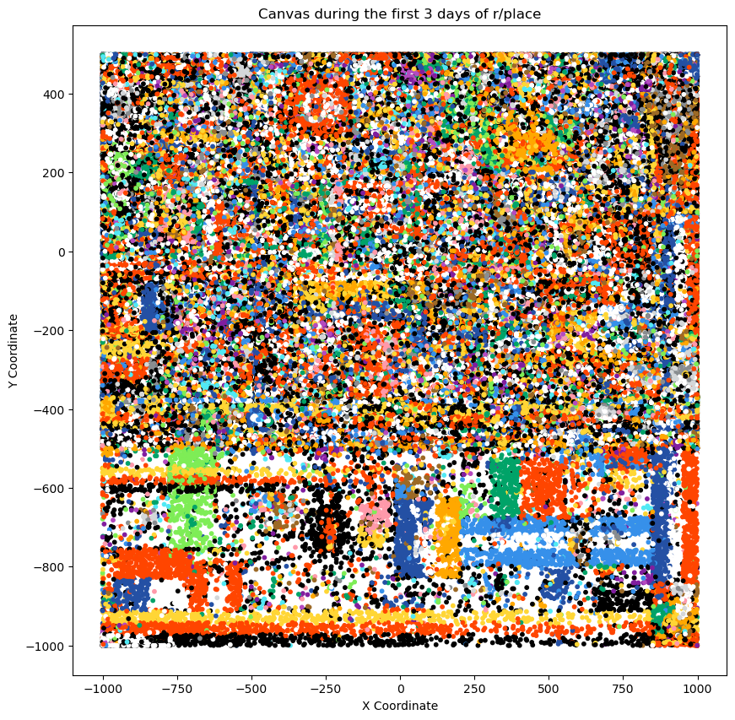
French Flags = Possible bots?
“At 20:00 CET an attack was launched at the top of the flag, managing to take over a small rectangle and turn it completely green. Help was given to horizontal German/Spanish/Hungarian flags stripe to get them to stretch across the big French flag.”

Slide 4
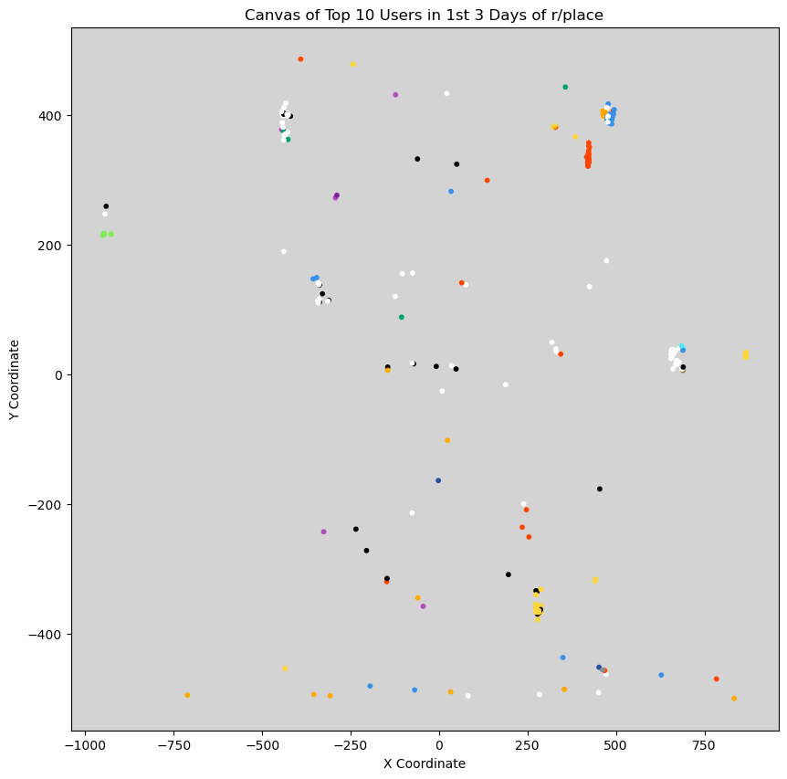
For the Top 10 users, there few blue and red pixels placed where French flags should be. There are gold dots where German flags were placed though.
Notes:
From our initial research recognizing bot activity, we found that bot activity is consistent and active. So we believe that the top 10 users would be bots because of their activity rate.

Slide 5
Conclusion - Are the French flags created by bots or real users?
French flags are probably not created by bots!
This is only sample data however.
There are strong communities interacting against each other.
Further investigation is needed.
“I don't know about bots - could be. I know there are several streamers involved and they're encouraging their tens of thousands of viewers to create accounts. They have scripts enabled to show what color the pixel should be, but a lot of groups are using those”, said a Reddit user discussing the French flag bot theory for r/place 2023.
Notes:
Quote source: https://www.reddit.com/r/place/comments/tvi97m/comment/i3b2o6e/

